Slide 1
COVID-19 Lockdowns and Waste Water Analysis Review

Slide 2
COVID-19 Data
Datasets
Two different data sets from Data.gov,
Pandemic response information by state on Wikipedia (https://en.wikipedia.org/wiki/U.S._state_
and_local_government_responses_to_the_COVID-19_pandemic)
Population data from Data.gov (https://www.census.gov/data/tables/time-series/demo/popest/2020s-state-total.html).

Slide 3
State Lockdown Information
State Lockdown information
California issued a stay-at-home order in mid-March of 2020 and did not lift it.
Oregon issued a stay-at-home order in mid-March of 2020 and did not lift it.
Texas issued a stay-at-home order in mid-March of 2020 and lifted it April 30.
Wisconsin declared a stay-at-home order to be unconstitutional and, therefore, did not issue an order.

Slide 4
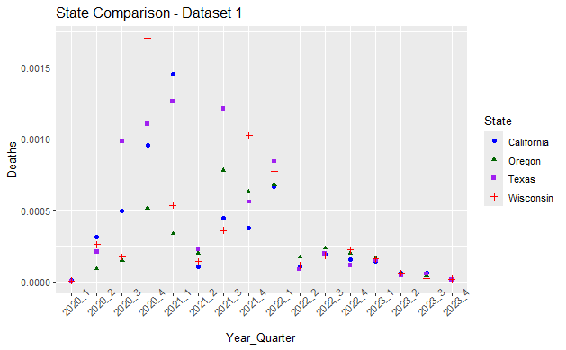
Were COVID Lockdowns Effective at Saving Lives? “Provisional Death Counts for Influenza, Pneumonia, and COVID-19”

Slide 5
Were COVID Lockdowns Effective at Saving Lives? Dataset 1
Conclusion Data set “Provisional Death Counts for Influenza, Pneumonia, and COVID-19”
The data visualization shows spikes in deaths in March and April of 20202 for all states. Lock downs were issued in March of 2020. After Texas reopened it had a spike in deaths that was not seen in states with lock downs. Wisconsin numbers were similar to Texas for quarters 2-4 in 2021. The first vaccine was available at the end of 20202 and numbers leveled out and rates were similar across all states regardless of lockdown policy.

Slide 6
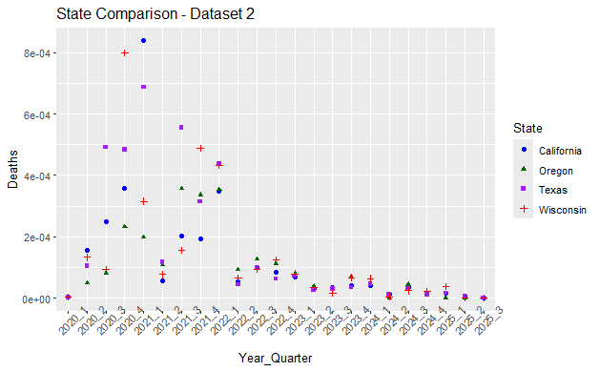
Were COVID Lockdowns Effective at Saving Lives? Dataset “Provisional COVID-19 death counts, rates, and percent of total deaths, by jurisdiction of residence”

Slide 7
Were COVID Lockdowns Effective at Saving Lives?
Conclusion data set “Provisional COVID-19 death counts, rates, and percent of total deaths, by jurisdiction of residence”
This data set shows convincing evidence that the tight policies, such as lock downs, saved large numbers of lives. The data visualization shows in the comparison of these four states that Texas had the highest death rates throughout the pandemic and Wisconsin had the second highest after 2021.

Slide 8
Is Testing Waste Water for COVID an Effective Method to Predict Active Cases?
Dataset
COVID-19 National Wastewater Data from the CDC.

Slide 9
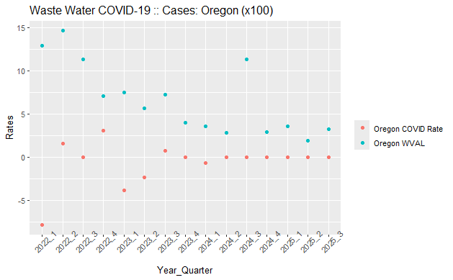
Is Testing Waste Water for COVID an Effective Method to Predict Active Cases?

Slide 10
Is Testing Waste Water for COVID an Effective Method to Predict Active Cases?
Conclusion
The waste water contamination rate does not match the number of reported cases. It would seem that waste water is not a good indicator of the number of cases. We are seeing symptoms decrease in severity so that infected people have little or no symptoms and, therefore, cases are not reported. This data on its own seems to indicate that waste water is not a good measure. The waste water data without disease symptom or severity information definitely has less value that it would have if it included these things.

